Slide 1


JAVA (Skill Based Lab)
MODULE 6: GUI Programming
Prof Indu Anoop

Slide 2
6.1 Applet and Applet Life Cycle
6.2 Creating Applet
6.3 Parameter Passing to Applet
6.4 Font and Color Class
6.5 AWT Components
6.6 SWING Classes in Java
6.7 JDBC

Slide 3
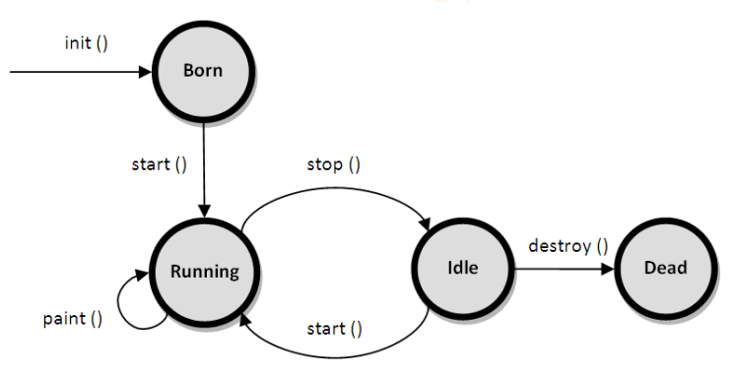
6.1 Applet and Applet Life Cycle
Applet is a special type of program that is embedded in the webpage to generate the dynamic content. It runs inside the browser and works at client side.
Advantage of Applet There are many advantages of applet. They are as follows:
It works at client side so less response time.
Secured
It can be executed by browsers running under many platforms, including Linux, Windows, Mac Os etc. The life cycle of an applet is as shown in the figure below

Slide 4
6.1 Applet and Applet Life Cycle
init(): The init() method is the first method to execute when the applet is executed. Variable declaration and initialization operations are performed in this method.
start(): The start() method contains the actual code of the applet that should run. The start() method executes immediately after the init() method. It also executes whenever the applet is restored, maximized or moving from one tab to another tab in the browser.
stop(): The stop() method stops the execution of the applet. The stop() method executes when the applet is minimized or when moving from one tab to another in the browser.
destroy(): The destroy() method executes when the applet window is closed or when the tab containing the webpage is closed. stop() method executes just before when destroy() method is invoked. The destroy() method removes the applet object from memory.
paint(): The paint() method is used to redraw the output on the applet display area. The paint() method executes after the execution of start() method and whenever the applet or browser is resized.

Slide 5
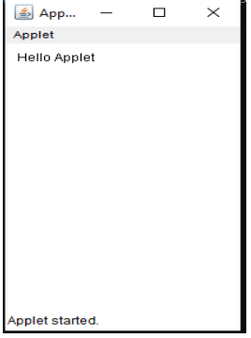
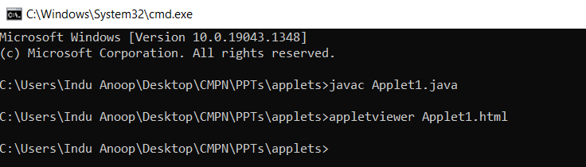
6.2 Creating Applet: Exp 16: Program on Applet Class
Write a program to print “Hello Applet” on applet viewer
NOTE: for running in eclipse, ensure jre version in build path is 1.8
//applet1.java
import java.awt.*;
import java.applet.*;
public class applet1 extends Applet {
String s;
public void init() {
s="Hello Applet";
}
public void paint(Graphics g) {
g.drawString(s,10,20);
}
}
//applet1.html
<html>
<body>
<applet code=applet1 width=200 height=300></applet>
</body>
</html>

Slide 6
6.3 Parameter Passing to Applet
We can get any information from the HTML file as a parameter. For this purpose, Applet class provides a method named getParameter()
Steps to accomplish this task -:
To pass the parameters to the Applet we need to use the param attribute of <applet> tag
To retrieve a parameter's value, we need to use the getParameter() method of Applet class
Example:
import java.applet.Applet;
import java.awt.Graphics;
public class UseParam extends Applet {
public void paint(Graphics g) {
String str=getParameter("msg");
g.drawString(str,50, 50);
}
}
//applet1.html
<html>
<body>
<applet code="UseParam.class” width=300 height=300></applet>
<param name=“msg” value=“Welcome to applet”>
</body>
</html>

Slide 7
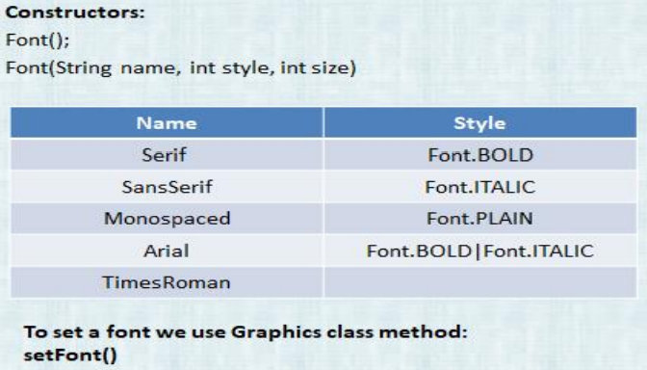
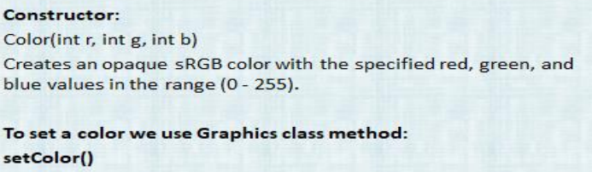
6.4 Font and Color Class
Font Class: The Font class states fonts, which are used to render text in a visible way
Color Class: The Color class states colors in the default sRGB color space or colors in arbitrary color spaces identified by a ColorSpace

Slide 8
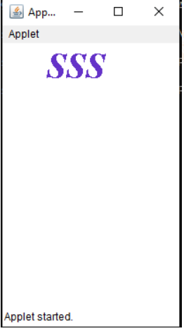
6.4 Font and Color Class
import java.awt.*;
import java.applet.*;
public class applet3 extends Applet {
public void paint(Graphics g) {
Font f=new Font("TimesRoman",Font.BOLD|Font.ITALIC,40);
Color c=new Color(100,50,200);
g.setFont(f);
g.setColor(c);
g.drawString("SSS",50,40);
}
}
//applet3.html
<html>
<body>
<applet code=applet3 width=200 height=300></applet>
</body>
</html>

Slide 9
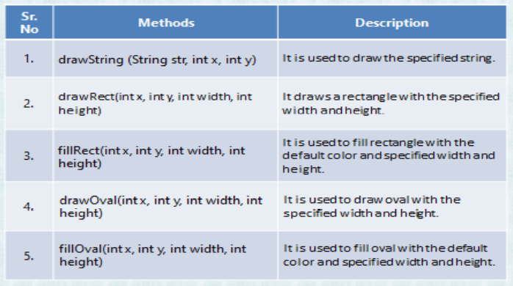
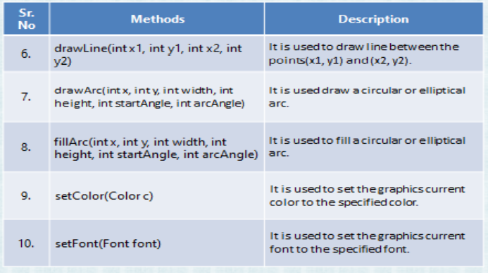
6.4 Graphics class methods

Slide 10
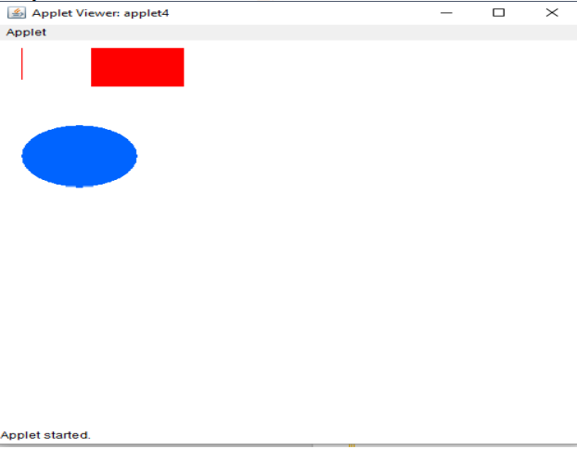
Exp 15: WAP to explain Graphics class methods
import java.awt.*;
import java.applet.*;
public class applet4 extends Applet {
public void paint(Graphics g) {
Color c1=new Color(255,0,0);
g.setColor(c1);
g.drawLine(20,10,20,50);
g.fillRect(80,10,80,50);
Color c2=new Color(0,0,255);
g.setColor(c2);
g.fillOval(20,110,100,80);
}
}
//applet4.html
<html>
<body>
<applet code=applet4 width=500 height=500></applet>
</body>
</html>

Slide 11
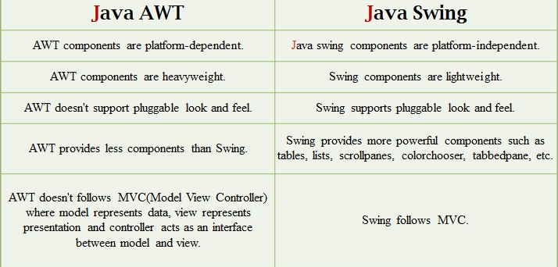
6.5 AWT Components:
AWT (Abstract Window Toolkit) is an API to develop GUI or window-based applications in java.
Java AWT components are platform-dependent i.e. components are displayed according to the view of operating system. AWT is heavyweight i.e. its components are using the resources of OS.
The java.awt package provides classes for AWT api such as TextField, Label, TextArea, RadioButton, CheckBox, Choice, List etc

Slide 12
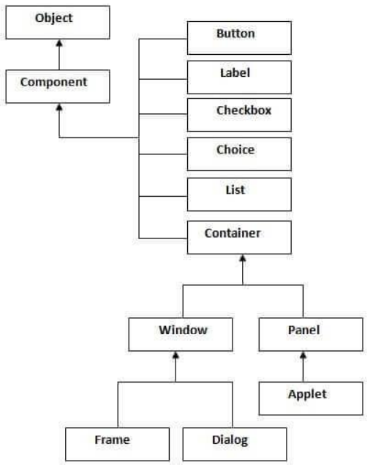
Java AWT Hierarchy:
Container: The Container is a component in AWT that can contain another components like buttons, textfields, labels etc. The classes that extends Container class are known as container such as Frame, Dialog and Panel.
Window: The window is the container that have no borders and menu bars. You must use frame, dialog or another window for creating a window.
Panel: The Panel is the container that doesn't contain title bar and menu bars. It can have other components like button, textfield etc.
Frame: The Frame is the container that contain title bar and can have menu bars. It can have other components like button, textfield etc.

Slide 13
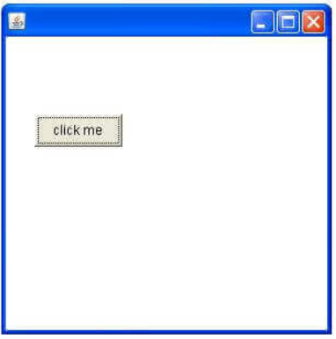
AWT Component Class Methods
Program:
import java.awt.*;
class First extends Frame {
First() {
Button b=new Button("click me"); b.setBounds(30,100,80,30);
// setting button position
add(b);
//adding button into frame
setSize(300,300);
//frame size 300 width and 300 height
setLayout(null);//no layout manager
setVisible(true);//now frame will be visible, by default not visible
}
public static void main(String args[]) {
First f=new First();
}
}

Slide 14
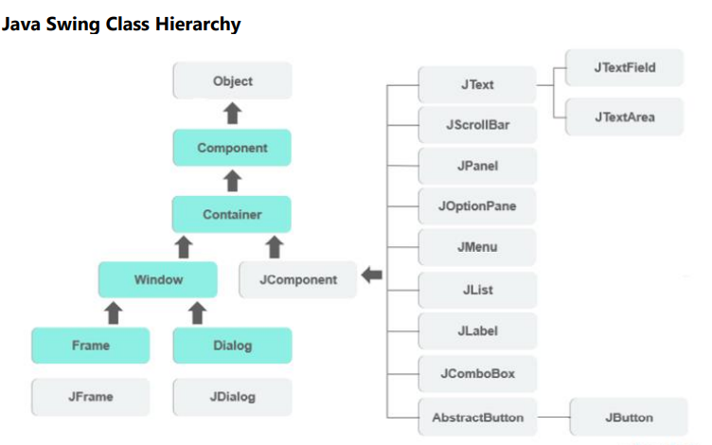
6.6 SWING Classes in Java
Swing in Java is a lightweight GUI toolkit which has a wide variety of widgets for building optimized window based applications. It is a part of the JFC( Java Foundation Classes). It is build on top of the AWT API and entirely written in java. It is platform independent unlike AWT and has lightweight components. It becomes easier to build applications since we already have GUI components like button, checkbox etc [Refer JavaSwingDemo.java from Class Materials (Teams)]

Slide 15
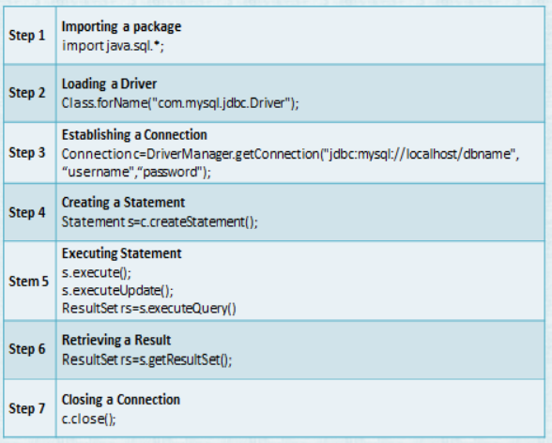
6.7 JDBC
JDBC stands for Java Database Connectivity, which is a standard Java API for databaseindependent connectivity between the Java programming language and a wide range of databases.
The JDBC library includes APIs for each of the tasks mentioned below that are commonly associated with database usage.
o Making a connection to a database.
o Creating SQL or MySQL statements.
o Executing SQL or MySQL queries in the database.
o Viewing & Modifying the resulting records.
We can use JDBC API to handle database using Java program and can perform the following activities:
o Connect to the database
o Execute queries and update statements to the database
o Retrieve the result received from the database
[Refer LoginDemo.java from Class Materials (Teams)]

